Slide 1
About Me
Oracle Certified Database Administrator
Sun Certified Java Programmer
Certified Ethical Hacker

Slide 2
What is Django:
Django is a web application framework written in Python programming language. It is based on MVT (Model View Template) design pattern. The Django is very demanding due to its rapid development feature. It takes less time to build application after collecting client requirement

Slide 3
Popularity
Django is widely accepted and used by various well-known sites such as:
Instagram
Mozilla
Disqus
Pinterest
Bitbucket
The Washington Times

Slide 4
Features of Django:
Rapid Development
Secure
Scalable
Fully loaded
Versatile
Open Source
Vast and Supported Community

Slide 5
Django Installation
To install Django, first visit to django official site (https://www.djangoproject.com) and download django by clicking on the download section. Here, we will see various options to download The Django
Django requires pip to start installation. Pip is a package manager system which is used to install and manage packages written in python. For Python 3.4 and higher versions pip3 is used to manage packages
pip3 install django==2.0.3
or pip install Django==5.0.1 for latest version

Slide 6
Verify Django Installation
After installing Django, we need to varify the installation. Open terminal and write python3 and press enter. It will display python shell where we can verify django installation.
C:\Users\Administrator>python
Python 3.11.0 (main, Oct 24 2022, 18:26:48) [MSC v.1933 64 bit (AMD64)] on win32
Type "help", "copyright", "credits" or "license" for more information.
>>> import django
>>> print(django.get_version())
4.2.4
>>>

Slide 7
Verify Django Installation continue…
Look at the Django version displayed by the print method of the python. Well, Django is installed successfully. Now, we can build Django web applications.
To create a Django project, we can use the following command. projectname is the name of Django application.
django-admin startproject projectname

Slide 8
Django Project
In the previous topic, we have installed Django successfully. Now, we will learn step by step process to create a Django application.
To create a Django project, we can use the following command. projectname is the name of Django application.

Slide 9
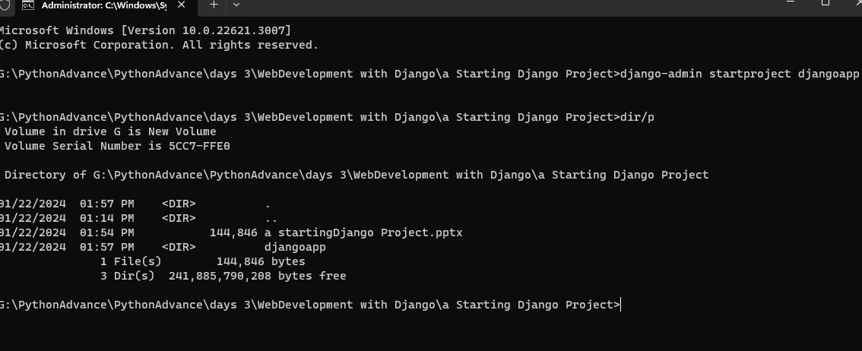

Slide 10
Now, move to the project by changing the directory. The Directory can be changed by using the following command.

Slide 11
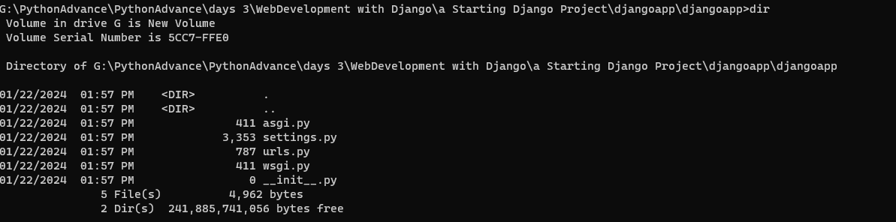

Slide 12
Django project contains the following packages and files. The outer directory is just a container for the application. We can rename it further.

Slide 13
manage.py: It is a command-line utility which allows us to interact with the project in various ways and also used to manage an application that we will see later on in this tutorial.
A directory (djangpapp) located inside, is the actual application package name. Its name is the Python package name which we'll need to use to import module inside the application.
__init__.py: It is an empty file that tells to the Python that this directory should be considered as a Python package.

Slide 14
settings.py: This file is used to configure application settings such as database connection, static files linking etc.
urls.py: This file contains the listed URLs of the application. In this file, we can mention the URLs and corresponding actions to perform the task and display the view.
wsgi.py: It is an entry-point for WSGI-compatible web servers to serve Django project.
Initially, this project is a default draft which contains all the required files and folders.

Slide 15
Running the Django Project
Django project has a built-in development server which is used to run application instantly without any external web server. It means we don't need of Apache or another web server to run the application in development mode.
To run the application, we can use the following command.
python manage.py runserver

Slide 16
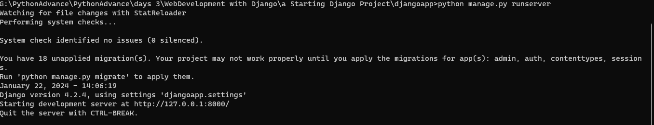

Slide 17
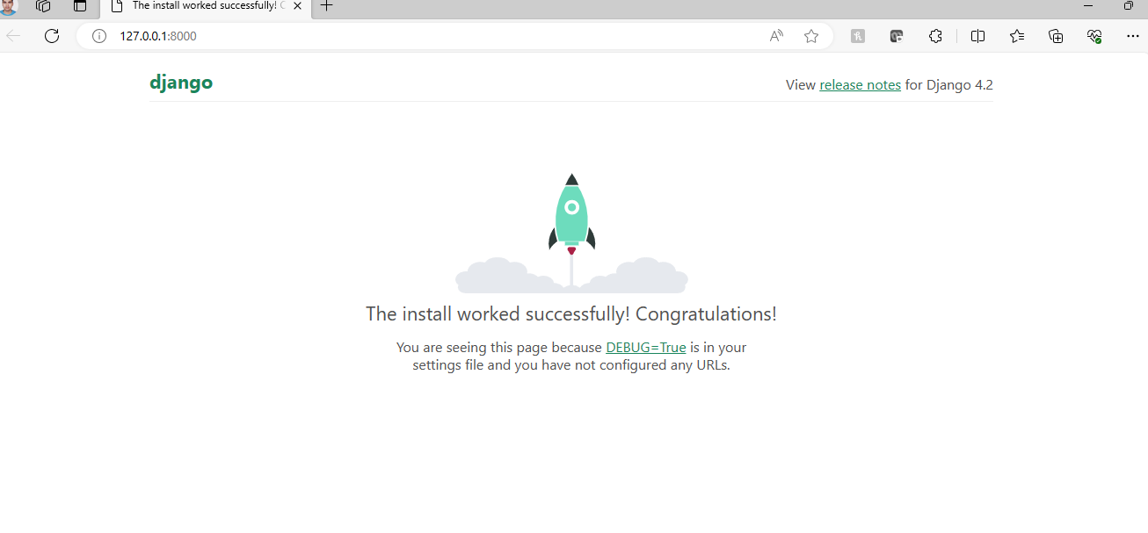
Look server has started and can be accessed at localhost with port 8000. Let's access it using the browser, it looks like the below.

Slide 18
Django Configuration with Apache Web Server
Django uses its built-in development server to run the web application. To start this server, we can use python manage.py runserver command.
But if we want to run our application by using apache server rather than built-in development server, we need Configure Apache.

Slide 19
Configure Apache:
Open your Apache configuration file (httpd.conf) using a text editor. You can find this file in the Apache installation directory.
Add the following lines at the end of the configuration file to load the mod_wsgi module and configure it to run your Django application. Adjust paths accordingly.

Slide 20
LoadModule wsgi_module modules/mod_wsgi.so
WSGIScriptAlias / "C:/path/to/your/project/myproject/wsgi.py"
WSGIPythonPath "C:/path/to/your/project"
<Directory "C:/path/to/your/project/myproject">
<Files wsgi.py>
Require all granted
</Files>
</Directory>

Slide 21
Replace "C:/path/to/your/project" with the actual path to your Django project.

Slide 22
Test Apache and Django Integration:
Restart Apache and test if your Django application is accessible through Apache. Open a web browser and go to http://127.0.0.1.
Note: Ensure that the necessary permissions are set for Apache to access your Django project directory.
Remember to replace paths and project names with your actual configurations. This guide assumes a basic setup, and you might need to adjust it based on your specific project structure and requirements.

